Slide 1
Recovery and management of system pressures
Dr Radhika Balu, Medical Director and Lisa Henschen, Managing Director and Harrow Health and Care system leads

Slide 2
Overview
The purpose of this presentation is to provide the Harrow Health Overview and Scrutiny Committee with an overview of the COVID recovery programme and management of system pressures in Harrow.
It includes information from all organisations who form the Harrow Health and Care Partnership and details where system pressures are faced and how recovery is being managed.
The Harrow Health and Care Executive meet weekly and come together to both collaboratively plan recovery efforts and work to manage system pressures, with the health, wellbeing and experience of Harrow residents at the fore.

Slide 3
Recovery context
January 2022 marked two years since the NHS started to treat the country’s first patients with COVID-19. December 2021 marked the anniversary of the first COVID-19 vaccine dose nationally, and locally for us, where The Hive administered Harrow’s first dose. These two years have been the most challenging in the history of the NHS for staff and patients alike. In January 2022, we are still managing the pandemic, and indeed have just stepped down from the level 4 emergency response, and alongside this, a recovery programme will be delivered.
As a Health and Care system, recovery is about restoring services and reducing the COVID backlogs; through increasing the number of people we see, care for, diagnose and treat. It is also about cementing what working in partnership over this period has achieved and accelerating the development of our local Borough Based Partnership to make the most effective use of resources to us across the health and care system and ensuring that we maintain a core focus on reducing health inequalities in the way we plan and deliver our services.
Local communities
Voluntary and Community Sector
Primary Care
Community Care
Mental Health services
Social Care
Hospital Care

Slide 4
Primary Care
On 27 January, NHS England and NHS Improvement wrote to all GP Practices outlining the next steps for general practice following the accelerated COVID-19 vaccination booster campaign.
For the period up until 31 March 2022, practices and Primary Care Networks (PCNs) are asked to focus on the following three key priority areas while continuing to use their professional judgement to clinically prioritise care:
At this time, key requirements were set out for General Practices:
Continued delivery of general practice services, which includes timely ongoing access for urgent care with clinical prioritisation, the ongoing management of long-term conditions, suspected cancer, routine vaccination and screening, annual health checks for vulnerable patients, and tackling the backlog of deferred care events.
Management of symptomatic COVID-19 patients in the community, as part of the local system approach, including supporting monitoring and access to therapeutics where clinically appropriate.
Ongoing delivery of the COVID-19 vaccination programme. It remains important that PCN Groupings focus on reaching the most vulnerable people and minimise any inequalities in uptake working with CCG, local authority, and community partners.

Slide 5
Primary Care
Covid response
Omicron – Peaked in January - rates came down but the cases are still high within the community.
New antiviral treatments are available against Covid since 16th Dec. GPs are contacting high risk patients who are eligible for treatment and referring them to a clinical decision-making service. We had a local drug delivery Unit at Northwick Park since January.
The COVID hub in Harrow closed on 31st January and primary care have absorbed the activity within GP practices and GP access centres.
Vaccinations : Thanks to local authority, we have a civic centre vaccination site available until end of Feb 22. Vaccinations now offered through mixture of practice and pharmacy sites
GP Practices
Increased sickness rates during January in primary care which has stabilized in February.
Have been open for face to face, telephone and digital consultations all through this wave. We have ensured that their doors have been open to patients.
Increased capacity in GP access centres through winter access funds to support practices and patients during winter.

Slide 6
Primary Care
Challenges /Objectives for 22/23
Reset and Recovery :
Our targets for health care outcomes for people with long term conditions needs to improve back to pre-COVID levels or better (for example, annual reviews of conditions).
North West London, in line with national policy, is focusing our priorities for recovery in the following areas: Maternity care, Early cancer diagnosis and ;ong term condition management, including hypertension (high blood pressure) so that a scheme for recovery can be developed for 22/23.
Access standards :
Consultations have changed remarkably when compared to pre- Covid in Primary care.
Telephone, face to face, video, e-consultations, secure text messaging and emails have been used as modes of consultations.
North West London are looking at establishing a minimum standard for access. They are working with Health Watch and patients to look at improving patient experience and increasing access.

Slide 7
Community Health Services: Recovery planning overview
The Clinic based services were reinstated 1st February 2022 following the redeployment of staff to our integrated services.
A review of waiting times for patients was undertaken, with a trajectory plan for al services with long waits in development
The core services have been maintained, such as D2A, Rapid response, district nursing throughout the pandemic
The recovery plan will be monitored within the Trust and shared with the NWL ICS

Slide 8
Recovery planning process
Data Validation of Lists
Calls to all patients requiring an appointment with long waits to ascertain if they still require the service.
Discharging of inactive patients
Accurate recording of patients that have been seen
Clinical Triage
Review and discussion with all patients waiting for non urgent interventions of how their needs can be best met
Clinicians are reviewing the waiting lists weekly to review and manage the waiting lists
Additional Capacity
Working with our temporary staffing provider to see how they can support filling existing vacancies or providing additional capacity
Identifying additional clinic space for Harrow Podiatry
Aiming to run evening and weekend clinics to provide additional capacity
We are looking to take part in a Trust-wide initiative to outsource podiatry activity.
Services in process of developing recovery plans
Quality
Identify services we need to complete harm reviews for patients
Process for stratifying large waiting lists to identify patients at greatest risk of harm

Slide 9
Harrow community services –Integrated care
CBU | Service |  |  |  |  | Covid Recovery
 |  | Longest wait (weeks) | Total waiting list - Current week | No. of Patients over 40 weeks | Waiting List (RAG) | How long to recover with current capacity? | What additional capacity needed to recover by end Q1 2022/23?
Harrow Integrated Care | Harrow Therapy Services | 40 | 963 | 0 |  | NA | recruit to existing vacancies
Harrow Integrated Care | Harrow Phlebotomy | 19 | 438 | 0 |  | N/A | Caseload cleansing
Harrow Integrated Care | Harrow Community Nursing | 18 | 216 | 0 |  | 2 months | recruit to existing vacancies
Harrow Integrated Care | Harrow Tissue Viability | 8 | 14 | 0 |  | N/A | Patents have been seen by Community nursing whilst awaiting TVN appointment

Slide 10
Harrow community services – Specialist services
CBU | Service |  |  |  |  | Covid Recovery
 |  | Longest wait (weeks) | Total waiting list - Current week | No. of Patients over 40 weeks | Waiting List (RAG) | How long to recover with current capacity? | What additional capacity needed to recover by end Q1 2022/23?
Brent & Harrow Specialist Services | Harrow Nutrition & Dietetics | 28 | 353 | 0 |  | 5 Months | 1 x B6
Brent & Harrow Specialist Services | Harrow Podiatry | 25 | 341 | 0 |  | 5 Months | 3 x B6
Brent & Harrow Specialist Services | Harrow Diabetes | 21 | 335 | 0 |  | 5 months | 1 x B7
Brent & Harrow Specialist Services | Harrow Respiratory | 15 | 43 | 0 |  | 3 months | 1 x B6
Brent & Harrow Specialist Services | Harrow Cardiology | 3 | 16 | 0 |  | 2 months | 1 x B7
Brent & Harrow Specialist Services | Harrow Specialist Neurology | 2 | 2 | 0 |  | NA | NA

Slide 11
Mental Health Services
Children
Increased number of children accessing Harrow CAMHS (see below table)
Waiting time targets being met in Harrow despite increases in demand
Addition Mental Health Support Team (MHST) supporting schools about to go live in February
New 0-5 service which will focus on early identification and prevention of children with potential mental health issues also about to go live in February
Extra capacity to help source waiting list reductions has been sourced through Healios which has gone live in January in Harrow. This will particularly focus on those waiting for ASD and CBT.
Dec-21 | CNWL Target 21/22 | CYP Access (One Contact)
Harrow | 1349 | 1574

Slide 12
Mental Health Services
Adults
MAS/ADHD/Psychology wait times initiatives underway funded by NHSE
Significant increase in referrals to Older Adults Community Mental Health Team 50% above pre-cv19 levels
Increase 30% in Adult community hub referrals
Single Point of Access (SPA) saw an 8% increase in calls in January from December. Winter monies used during this period to increase capacity in the SPA. Carrying out a review of the SPA in line with wider CNWL transformation as an essential service in the pathway. This includes, making the SPA all age, reviewing skill mix of staff, and embedding trauma informed care.

Slide 13
Social Care Services: Key Pressures Quarter 3 2021-22
‘Demand’ remains high; For first conversations, Care Act assessments OT assessments and reviews.
60 new requests per week - up 24% on pre-pandemic levels
Teams unable to complete work quickly enough to avoid growing queues and backlog
200+ people in the community waiting to start a conversation with us
More than 3 months of work queued up with people
Before the pandemic an average 9.5 new clients a week received Care Act eligible support out of hospital
the equivalent figure today is 13.1
it takes on average more than 2 weeks before our community team have capacity to begin working with citizens who have been discharged from hospital
Due to very high case loads staff are unable to complete annual reviews on every citizen.
Safeguarding enquiries (investigations) remain high compared to the previous two years.
Complexity of needs for people with learning disabilities through pandemic is leading to significant increases in the cost of supporting them
average increase required in LD adds £337/week to care costs, c.f. £200/week before pandemic

Slide 14
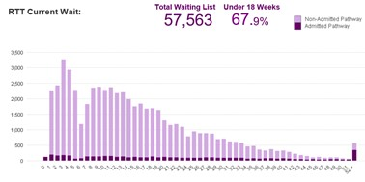
Hospital services: 18 Weeks Referral to Treatment Waiting List - current
Summary compared to 19/20 pre-pandemic baseline:
Outpatient recovery: 95% activity recovered to date
Elective recovery: 85% activity recovered to date
Long waiter recovery (patients waiting over 52 weeks for first definitive treatment)
All 52 week waiters continue to be tracked for next steps to support the plan to get to 285 reported breached by Mar-22
LNWHT remains in an improving position month on month
Trust is reducing formal validated 52 week waiters by c50 patients each month
Trust is reducing the tip over risk for year end (Mar-22) by c200 patients each month
Comparison of long waiting list recovery reporting latest final validated month end position (Dec-22):
LNWHT 563 x 52 ww, reducing consistently across the last 8 months
CWFT 485, increasing across last 2 months
THH 970, reducing across last 2 months
Imperial 1,650, increasing across last 5 months
52 Weeks - Trust validated month end position:
Ops Plan | Apr-21 | May-21 | Jun-21 | Jul-21 | Aug-21 | Sep-21 | Oct-21 | Nov-21 | Dec-21 | Jan-22 | Feb-22 | Mar-22
Total 52ww Plan | 2204 | 1591 | 1507 | 1431 | 1171 | 1029 | 900 | 800 | 700 | 600 | 500 | 285
Total 52ww Actual | 1609 | 1180 | 912 | 846 | 843 | 662 | 675 | 597 | 563 | 499 Provisional

Slide 15
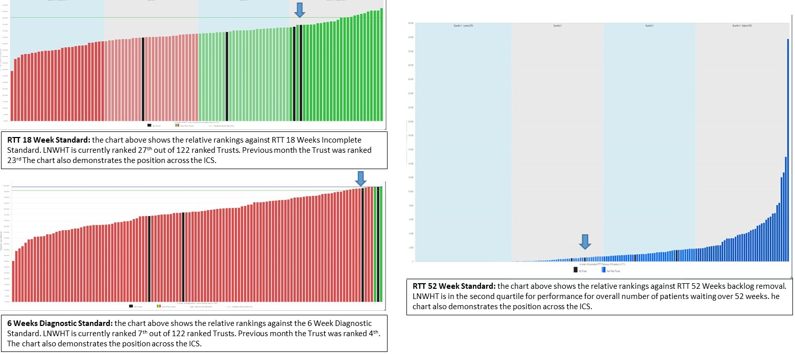
Hospital services: National Performance Summary – Planned Care Data source: Model Hospital. LNWHT is the arrow Summary: - LNWHT is in the top quartile for 18 Weeks Referral to Treatment and for 6 week diagnostic waits performance. - LNWHT is in the second highest quartile for total number of patients waiting more that 52 weeks (this is total patients and not weighted by size of Trust waiting lists)

Slide 16
Summary and close The Health and Care System has now moved into recovery. This presentation has demonstrated that the need for health and care services as a result of the pandemic is significant. Progress in addressing these needs is already being made and will remain a central focus of the Harrow partnership.

